Slide 1
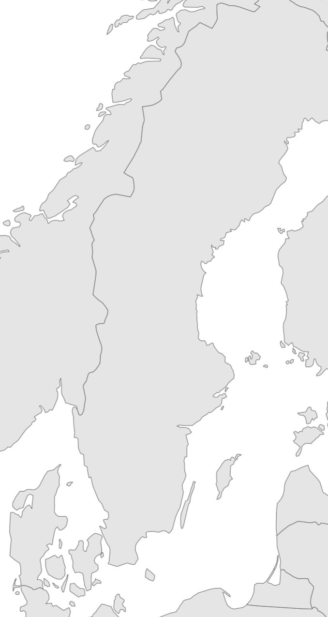
Compiling time series
~7000
1985-
Boxes indicate catch-years, note that “birth years” or cohorts extend up to >10 years prior to the first catch year
Numbers in blue estimation of # of sampled individuals.
Each individual has about 1-9 back-calculated lengths, depending on how old it was when caught
Large sample sizes! Can detect small changes
~10k
~8.6k
1970-
1977-
~10k
1977-
~2.5k
1991-2004
1991-2006
1971-
~10k
~4.5k
~11.5k
1963-
~3.5k
2003-

Slide 2
Compiling time series
Lat 63, Lon 20
1985-
Lat and long for selected stations
Lat 60, Lon 20
1970-
1977-
1977-
1991-2004
1991-2006
1971-
1963-
Lat 55, Lon 15
2003-

Slide 3
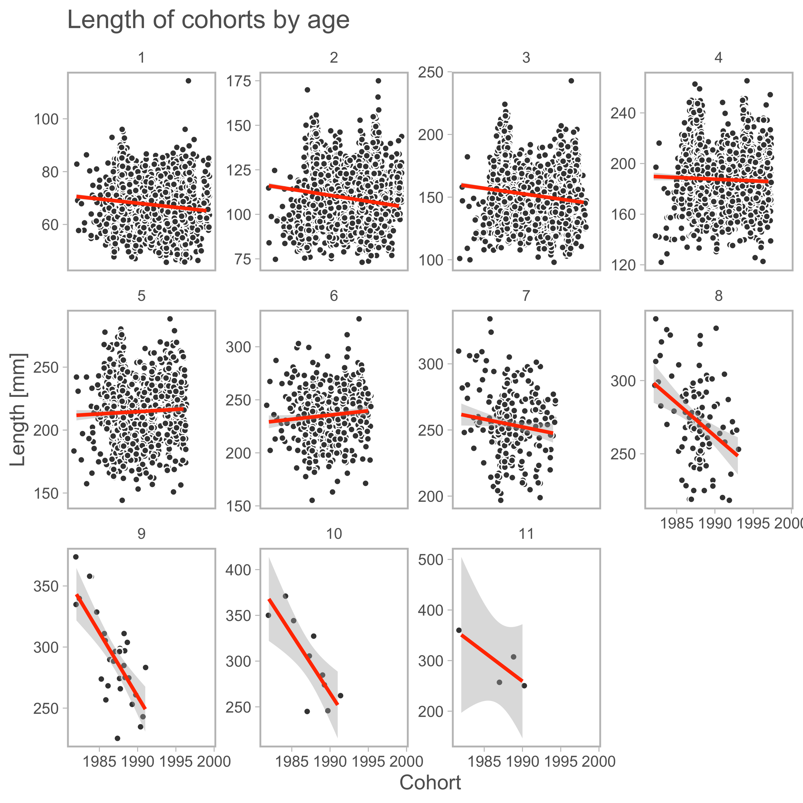
1985-
1970-
1977-
1977-
1991-2004
1991-2006
1971-
1963-
2003-

